Slide 1
SQL Server R Services ABQSQL, January 8, 2016

Slide 2
About Me
Chris Hyde
Owner and Principal Consultant for Hydrate Consulting
MCSA – SQL Server 2008, MCITP
15+ Years experience with SQL Server
Contact Me:
Email: chris@hydrate.consulting, chrishyde325@gmail.com
Twitter: @ChrisHyde325

Slide 3

The Obligatory XKCD Strip
Source: https://xkcd.com/327/

Slide 4
What the Developer Wrote
OleDbConnection myConn = new OleDbConnection("Provider=SQLOLEDB;Data Source=servername;Integrated Security=SSPI;Initial Catalog=dbname");
OleDbCommand sqlQuery = myConn.CreateCommand();
sqlQuery.CommandText = "SELECT FirstName, LastName, GPA FROM dbo.Students WHERE (FirstName = '";
sqlQuery.CommandText = sqlQuery.CommandText + strLastName;
sqlQuery.CommandText = sqlQuery.CommandText + "') AND (LastName = '";
sqlQuery.CommandText = sqlQuery.CommandText + strFirstName;
sqlQuery.CommandText = sqlQuery.CommandText + "')";

Slide 5
What the Developer Expected
SELECT FirstName, LastName, GPA FROM dbo.Students WHERE (FirstName = 'Robert') AND (LastName = 'Smith');
SELECT
FirstName,
LastName,
GPA
FROM
dbo.Students
WHERE
(FirstName = 'Robert')
AND
(LastName = 'Smith');

Slide 6
What the Database Actually Sees
SELECT FirstName, LastName, GPA FROM dbo.Students WHERE (FirstName = 'Robert'); DROP TABLE Students;--’) AND (LastName = 'Smith');
SELECT
FirstName,
LastName,
GPA
FROM
dbo.Students
WHERE
(FirstName = 'Robert');
DROP TABLE Students;
--’) AND (LastName = 'Smith');

Slide 7
Installing SQL Server R Services, part 1
1. Install Advanced Analytics Extensions
https://msdn.microsoft.com/en-US/library/mt590808.aspx

Slide 8
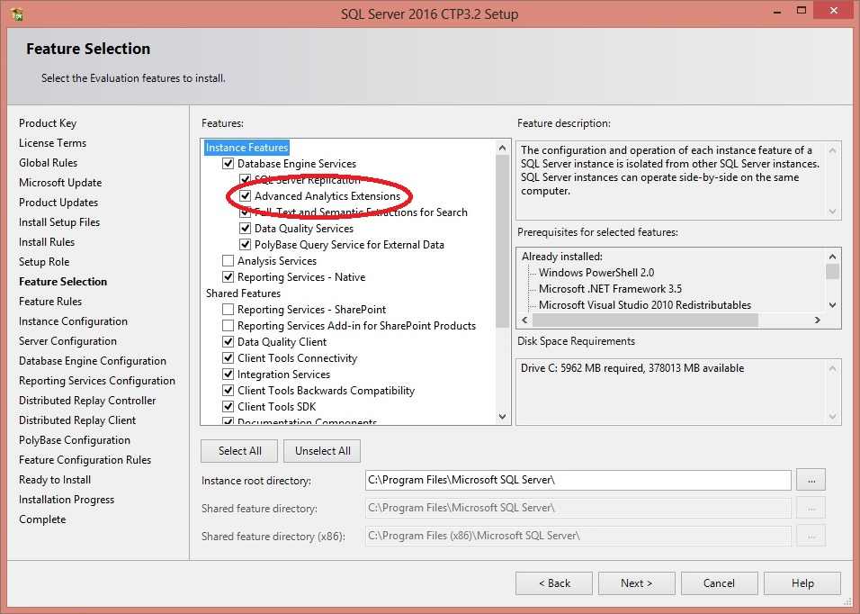
Installing SQL Server R Services, part 2

Slide 9
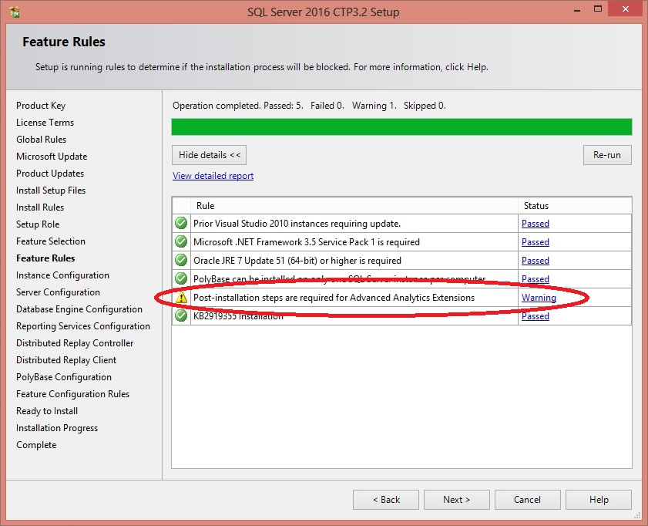
Installing SQL Server R Services, part 3

Slide 10
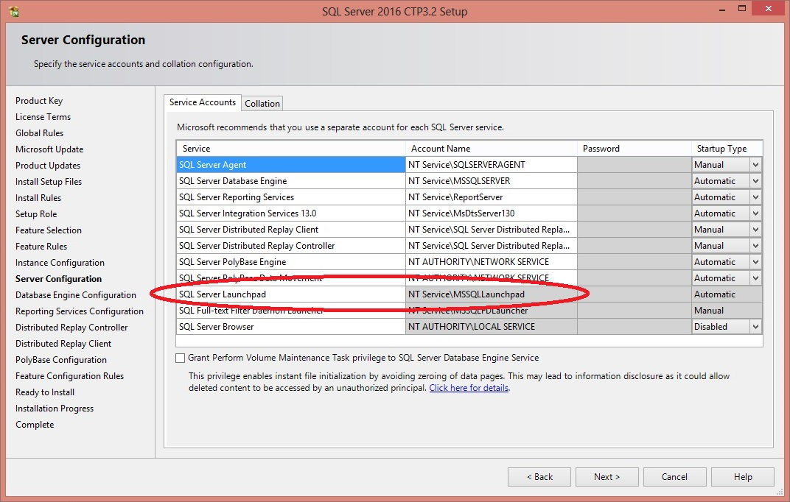
Installing SQL Server R Services, part 4

Slide 11
Installing SQL Server R Services, part 5
2. Install Revolution R Open 3.2.2 on database server
(R runtime engine)
3. Install Revolution R Enterprise 7.5 on database server
(R platform)
https://msdn.microsoft.com/en-US/library/mt590809.aspx

Slide 12
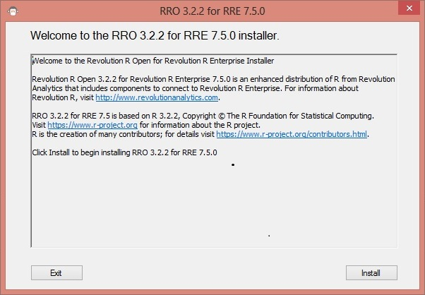
Installing SQL Server R Services, part 6

Slide 13
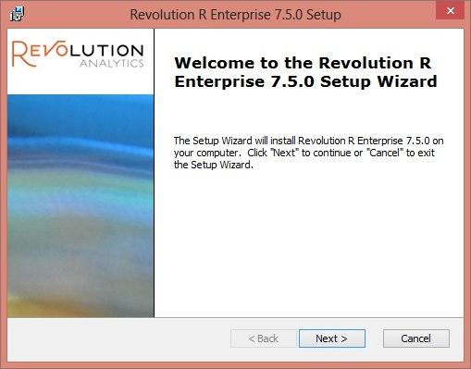
Installing SQL Server R Services, part 7

Slide 14
Installing SQL Server R Services, part 8
Post-installation scripts and configuration
1. Enable external scripts
EXEC sp_configure 'external scripts enabled', 1;
RECONFIGURE;
2. Configure memory appropriately
3. Post-installation command script
https://msdn.microsoft.com/en-US/library/mt590536.aspx

Slide 15
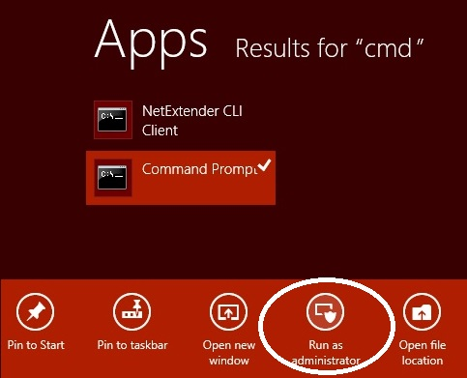
Installing SQL Server R Services, part 9

Slide 16
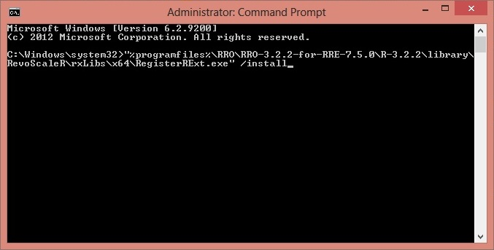
Installing SQL Server R Services, part 10

Slide 17
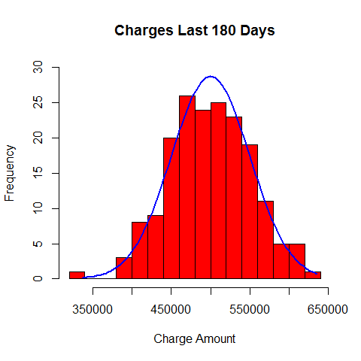
Distribution of Charges

Slide 18
Sanitize Your Database Input
Handle special characters used in SQL Injection attacks
‘; ‘); used to terminate WHERE clause
-- # used to comment out rest of query statement
Handle keywords passed as input
DROP, CREATE, GRANT, etc.

Slide 19
Use Appropriate Lengths for Input
Don’t allow more characters for the input than necessary
Use database field length as a guide
The same rules apply for data types
i.e. don’t allow text input for a numeric field

Slide 20
Use Stored Procedures in Data Layer, part 1
CREATE PROCEDURE dbo.uspSelectGradesByStudent
(
@FirstName VARCHAR(25),
@LastName VARCHAR(25)
)
AS
BEGIN
SELECT
FirstName,
LastName,
GPA
FROM
dbo.Students
WHERE
FirstName = @FirstName
AND
LastName = @LastName;
END;

Slide 21
Use Stored Procedures in Data Layer, part 2
-- Deliberate bad example!!!
CREATE PROCEDURE dbo.uspSelectGradesByStudent
(
@FirstName VARCHAR(25),
@LastName VARCHAR(25)
)
AS
BEGIN
DECLARE @Query NVARCHAR(4000);
SET @Query = 'SELECT FirstName, LastName, GPA FROM dbo.Students WHERE ';
SET @Query = @Query + 'FirstName = ''' + @FirstName + ''' AND LastName = ';
SET @Query = @Query + '''' + @LastName + '''';
EXEC (@Query);
END;

Slide 22
Use Stored Procedures in Data Layer, part 3
-- Deliberate bad example!!!
CREATE PROCEDURE dbo.uspSelectGradesByStudent
(
@FirstName VARCHAR(25) = NULL,
@LastName VARCHAR(25) = NULL
)
AS
BEGIN
DECLARE @Query NVARCHAR(4000);
SET @Query = 'SELECT FirstName, LastName, GPA FROM dbo.Students'
IF @FirstName IS NOT NULL OR @LastName IS NOT NULL
SET @Query = @Query + ' WHERE ';
IF @FirstName IS NOT NULL
SET @Query = @Query + 'FirstName = ''' + @FirstName + '''';
IF @FirstName IS NOT NULL AND @LastName IS NOT NULL
SET @Query = @Query + ' AND ';
IF @LastName IS NOT NULL
SET @Query = @Query + 'LastName = ''' + @LastName + '''';
EXEC (@Query);
END;

Slide 23
Use Stored Procedures in Data Layer, part 4
CREATE PROCEDURE dbo.uspSelectGradesByStudent
(
@FirstName VARCHAR(25) = NULL,
@LastName VARCHAR(25) = NULL
)
AS
BEGIN
SELECT
FirstName,
LastName,
GPA
FROM
dbo.Students
WHERE
(@FirstName IS NULL
OR
FirstName = @FirstName)
AND
(@LastName IS NULL
OR
LastName = @LastName)
END;

Slide 24
Use Stored Procedures in Data Layer, part 5
-- Parameterized SQL example
CREATE PROCEDURE dbo.uspSelectGradesByStudent
(
@FirstName VARCHAR(25),
@LastName VARCHAR(25)
)
AS
BEGIN
DECLARE @Query NVARCHAR(4000);
DECLARE @Parameters NVARCHAR(500);
SET @Parameters = '@LastName VARCHAR(25), @FirstName VARCHAR(25)';
SET @Query = 'SELECT FirstName, LastName, GPA FROM dbo.Students WHERE ';
SET @Query = @Query + 'FirstName = ''' + @FirstName + ''' AND LastName = ';
SET @Query = @Query + '''' + @LastName + '''';
EXEC sp_executesql @Query, @Parameters, @FirstName, @LastName;
END;

Slide 25
MySQL Prepared Statements
-- Prepared statement example
PREPARE statement FROM "SELECT FirstName, LastName, GPA FROM Students WHERE FirstName = ? AND LastName = ?";
SET
@FirstName = 'Robert',
@LastName = 'Smith';
EXECUTE statement USING @FirstName, @LastName;
DEALLOCATE PREPARE statement;

Slide 26
Security Best Practices
Specific database login for the data layer
Only has access to CRUD (create, read, update, delete) actions on needed tables and stored procedures
Principle of least privilege: Minimum but Necessary

Slide 27
Additional LAMP Practice
Watch out for other types of code injection
HTML injection
Cross-site scripting (CSS) injection

Slide 28
Resources
Writing Secure Dynamic SQL in SQL Server:
https://msdn.microsoft.com/en-us/library/bb669091(v=vs.110).aspx
Using sp_executesql
https://msdn.microsoft.com/en-us/library/ms188001.aspx

